Slide 1
Machine Learning For Transport and Mixing Processes
CIEG 678 Ryan Schanta
Ye et al. 2021

Slide 2

Overview
Review of PINNs
PINNs for RANS Closure Problems
Automatic Differentiation
Demo: Building a PINN
Problem Formulation
Coding Strategy
Analysis & Adapting to Results
Summary

Slide 3
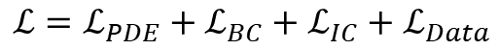
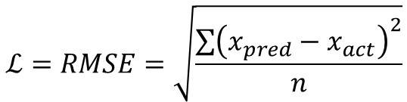
Recap: PINNS
Standard “Data Science” Metrics
Physics Informed Neural Network
$$ℒ=RMSE=\sqrt{\frac{\sum{{\left(x_{pred}−x_{act}\right)}^{2}}}{n}}$$
$$ℒ=ℒ_{PDE}+ℒ_{BC}+ℒ_{IC}+ℒ_{Data}$$
Leverages information about problem
Choose to enforce:
Governing PDES
Navier Stokes
Conservation of Mass
Known Parametrizations
Boundary Conditions
Initial Conditions
RMSE/Data (if known)
Comparatively expensive
Domain knowledge required
Goal of ML model: minimize loss term
Challenges
Overfitting
Insufficient Data
Generalizability

Slide 4
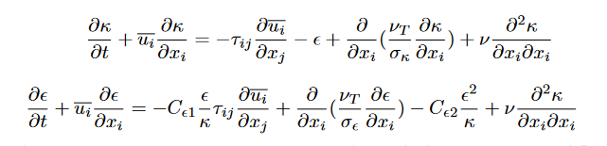

PINNS in RANS
RANS 2-equation model
Concept: $k−ε$ provides another constraint!
Goal: Can we tune the parameters with DNS data to get better coefficients for certain geometries?
Relies on empirical coefficients
Implications: Efficient use of physical constraints and available data
$$C_{μ}=0.09$$ | $$σ_{k}=1.0$$ | $$σ_{ε}=1.3$$ | $$C_{1ε}=1.44$$ | $$C_{2ε}=1.92$$
From S. Luo et al (2020)

Slide 5
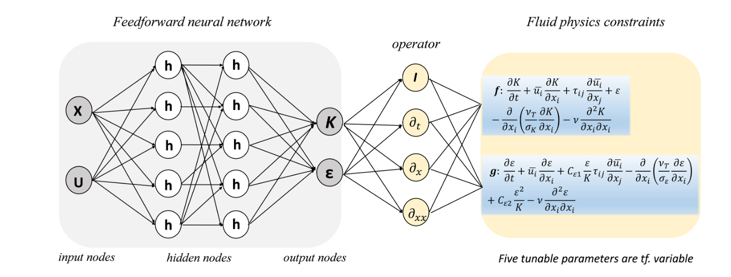

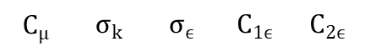

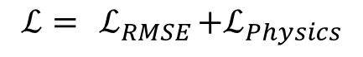
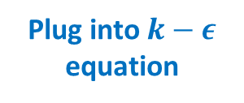
PINNS in RANS
$$ℒ= { ℒ}_{RMSE}+ℒ_{Physics}$$
$$argmin(ℒ)$$
$$C_{μ}$$ | $$σ_{k}$$ | $$σ_{ϵ}$$ | $$C_{1ϵ}$$ | $$C_{2ϵ}$$
Feedforward Neural Network for $k$ and $ε$
Differentiate
Outputs
Plug into $k−ε$ equation
Minimize Loss
From S. Luo et al (2020)

Slide 6

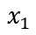
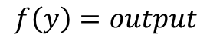
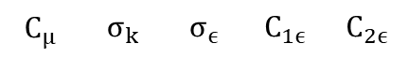
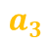
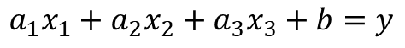

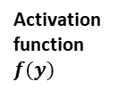
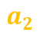
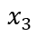

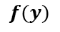
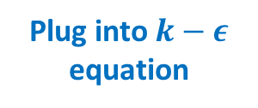

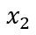
PINNS in RANS
Recall: Networks have learnable weights and biases
Bias
Activation function $f(y)$
$$ℒ= { ℒ}_{RMSE}+ℒ_{Physics}$$
$$1$$
Hyperparameters/Design Choices
Number of Layers
Activation Function
Batching strategy
$$b$$
$$x_{1}$$
$$a_{1}$$
Input Parameters
$$a_{2}$$
$$∑$$
$$f(y)$$
$$argmin(ℒ)$$
$$x_{2}$$
$$a_{3}$$
$$x_{3}$$
$$C_{μ}$$ | $$σ_{k}$$ | $$σ_{ϵ}$$ | $$C_{1ϵ}$$ | $$C_{2ϵ}$$
Minimize Loss
$$a_{1}x_{1}+a_{2}x_{2}+a_{3}x_{3}+b=y$$
$$f\left(y\right)=output$$
Plug into $k−ε$ equation
Feedforward Neural Network for $k$ and $ε$
Differentiate
Outputs
From S. Luo et al (2020)

Slide 7
PINNS in RANS
Derivatives of outputs needed
Typical methods cost prohibitive
Finite differences
Symbolic math
$$ℒ= { ℒ}_{RMSE}+ℒ_{Physics}$$
$$argmin(ℒ)$$
Automatic Differentiation- elegant solution
Computer arithmetic and data structures
Concept: Everything is chain-rulable!
$$C_{μ}$$ | $$σ_{k}$$ | $$σ_{ϵ}$$ | $$C_{1ϵ}$$ | $$C_{2ϵ}$$
Feedforward Neural Network for $k$ and $ε$
Differentiate
Outputs
Plug into $k−ε$ equation
Minimize Loss
From S. Luo et al (2020)

Slide 8
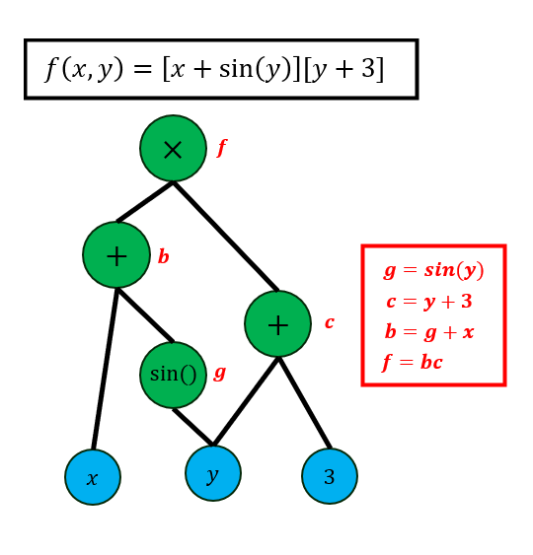

Slide 9
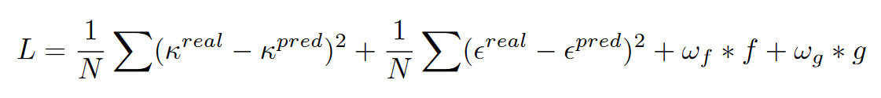
PINNS in RANS
Auto-differentiate and plug into RANS equations
$$ℒ= { ℒ}_{RMSE}+ℒ_{Physics}$$
Calculate Loss
Both DNS and Physics!
$$argmin(ℒ)$$
Iteratively adjust!
$$C_{μ}$$ | $$σ_{k}$$ | $$σ_{ϵ}$$ | $$C_{1ϵ}$$ | $$C_{2ϵ}$$
Feedforward Neural Network for $k$ and $ε$
Differentiate
Outputs
Plug into $k−ε$ equation
Minimize Loss
From S. Luo et al (2020)

Slide 10
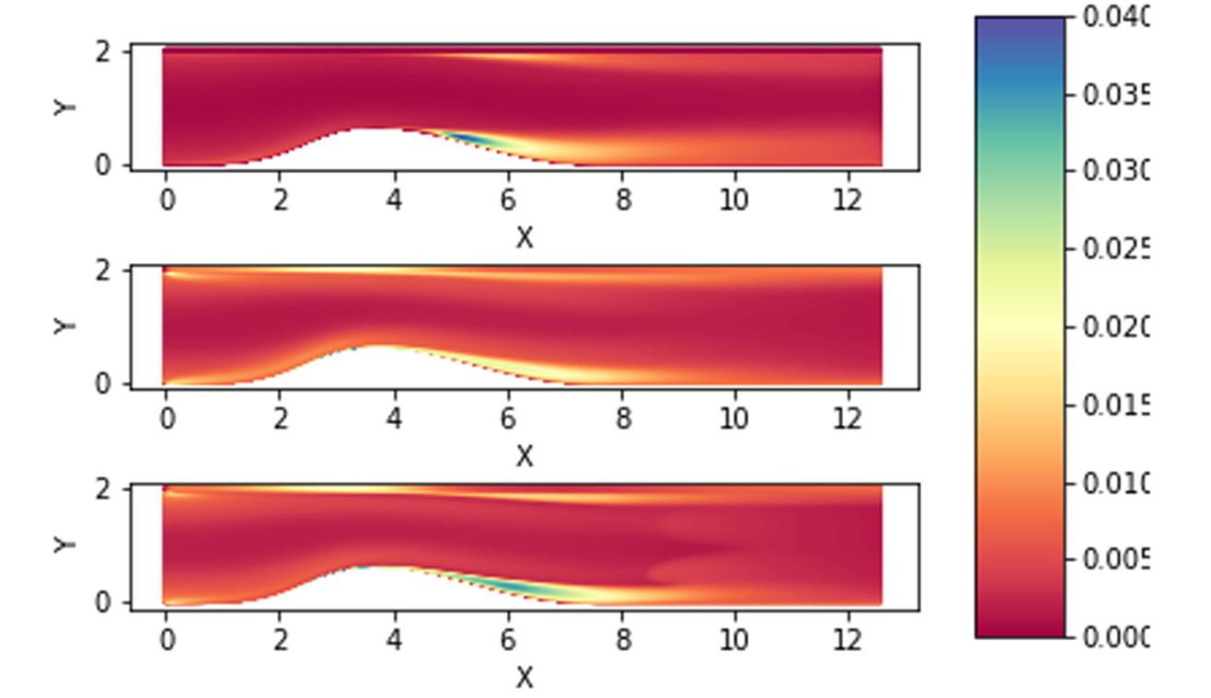
PINNS in RANS: Results
DNS
Prediction of Flow Separation
Classically difficult case
PINN-calibrated RANS: 22% improvement
Doesn’t completely get it
Standard RANS
Takeaways
Middle-ground
Still RANS at the end of the day
Used to improve existing methodologies, not replace them!
PINN Enhanced RANS
Comparison of the time averaged turbulent kinetic energy
From S. Luo et al (2020)
Original | $$C_{μ}=0.09$$ | $$σ_{k}=1.0$$ | $$σ_{ε}=1.3$$ | $$C_{1ε}=1.44$$ | $$C_{2ε}=1.92$$
PINN | $$C_{μ}=0.09$$ | $$σ_{k}=0.750$$ | $$σ_{ε}=0.273$$ | $$C_{1ε}=1.302$$ | $$C_{2ε}=1.862$$

Slide 11
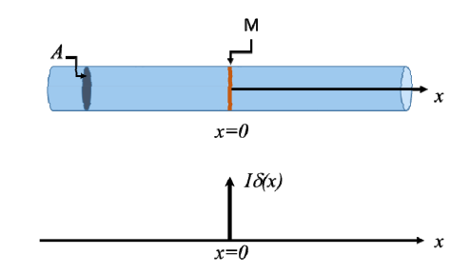
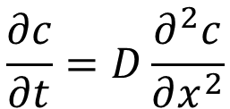
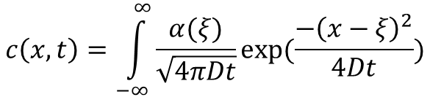
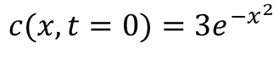
Building a PINN from Scratch
Example 1.4: 1D Diffusion Problem
Assume some initial distribution
Gaussian spike
Triangular spike
$$\frac{∂c}{∂t}=D\frac{∂^{2}c}{∂x^{2}}$$
$$c(x,t=0)=3e^{−x^{2}}$$
$$c\left(x,t\right)=\int_{−∞}^{∞}{\frac{α(ξ)}{\sqrt{4πDt}}exp⁡(\frac{−{\left(x−ξ\right)}^{2}}{4Dt})}$$

Slide 12
Building Blocks
How many layers?
How many nodes per layer?
Which activation functions?
Dropout? Convolution? Other operations?
Neural Network Architecture
PDE Condition
$$ℒ_{total}=ℒ_{PDE}+λ_{IC}ℒ_{IC}+λ_{BC}ℒ_{BC}$$
Loss Function with Conditions to Enforce
Initial Condition
Relative weight factors for IC/BC/PDE losses
Boundary Condition

Slide 13
Code Process
1. Define some neural network that takes in 2 inputs and ends up with 1 output
More involved than a standard Keras/TF network
Need to go “under the hood” for Loss Function
Several libraries have since been developed
Most use some version of gradient tape
Not yet a fully “standardized” workflow in any domain!
2. Set up a loop to repeatedly run through network and update weights
2a. Set up a gradient tape on the trainable variables for gradient descent
2b. Set up a gradient tape on the output parameters for auto-differentiating boundary conditions
2c. Calculate your loss from PDE, IC, and BC weighting
2d. Perform gradient descent* to march the loop forward
*Many optimization algorithms are available! I used Adam
3. Repeat until convergence

Slide 14
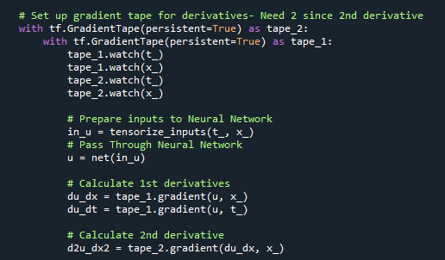
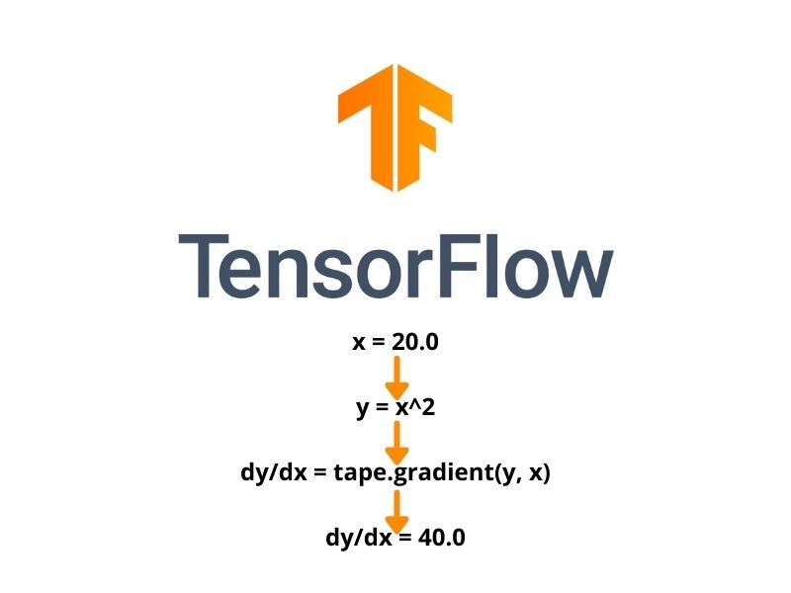

Slide 15
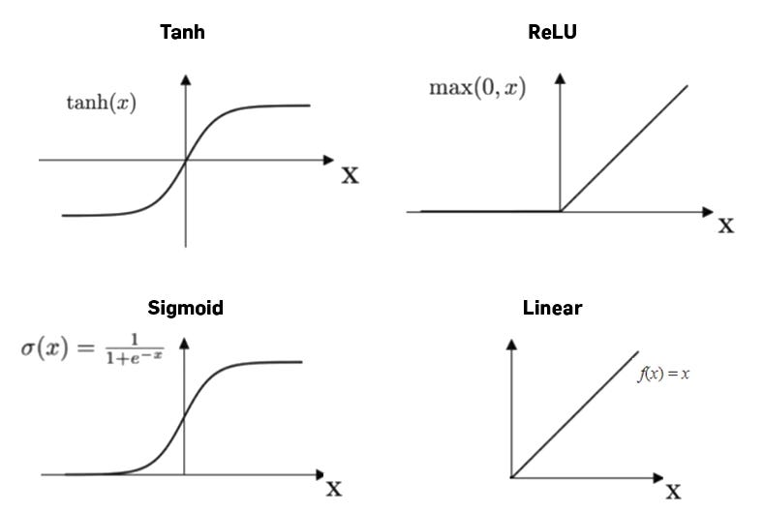
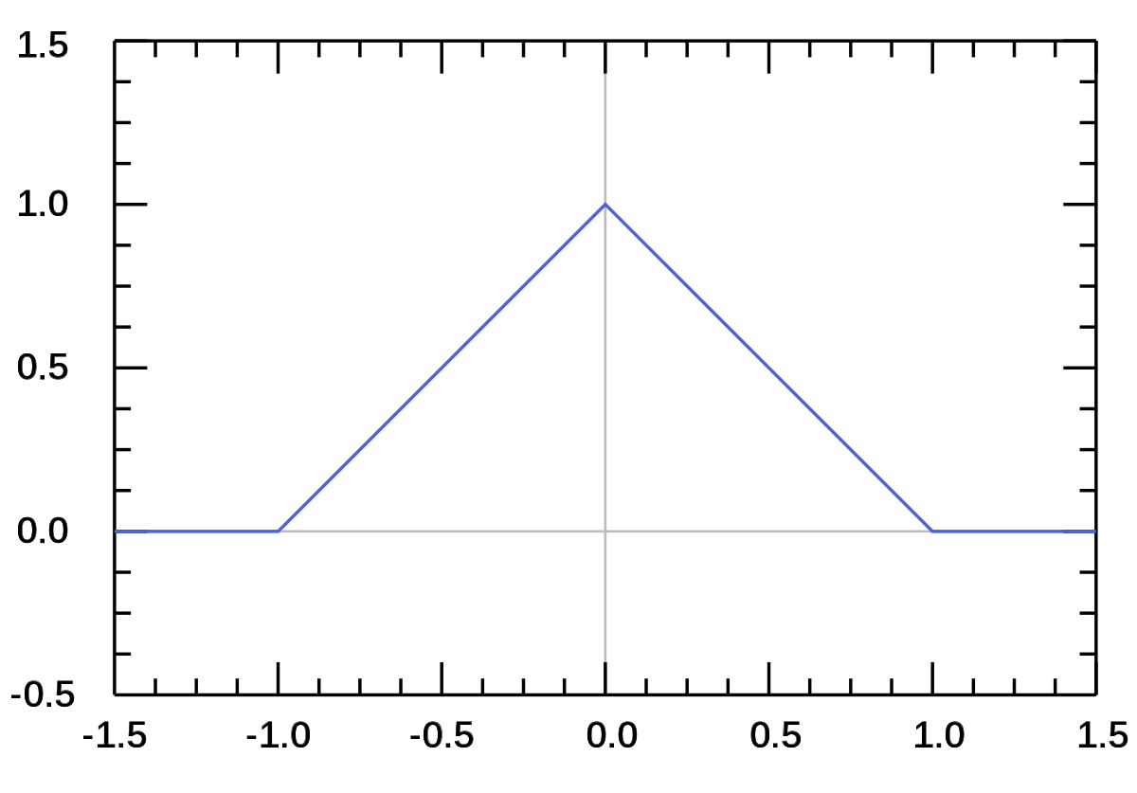
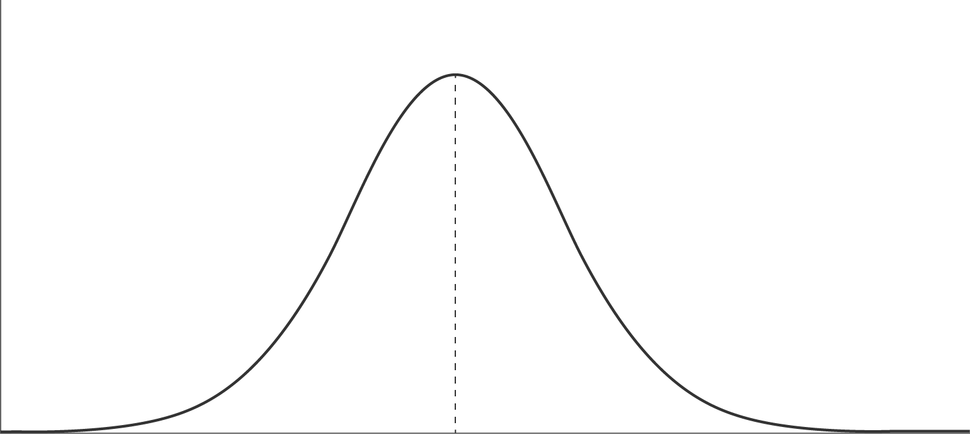


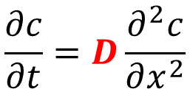
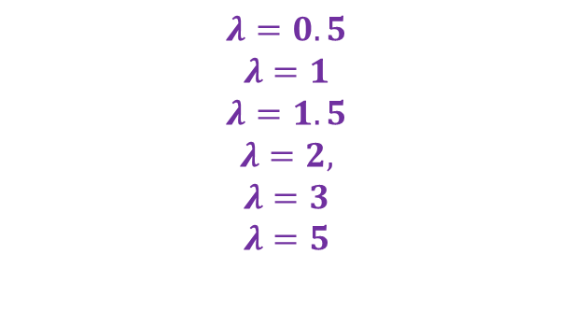
Parameter Hyperparameter Choices
4 Layers
64 Nodes each layer
250 epochs
Kept Constant
$$\frac{∂c}{∂t}=D\frac{∂^{2}c}{∂x^{2}}$$
Ignored for now
$$ℒ_{total}=ℒ_{PDE}+λ_{IC}ℒ_{IC}+λ_{BC}ℒ_{BC}$$
Tried $D=1$ and $D=2$
Tried $tanh$ and $ReLU$ activation functions
$$λ=0.5$$
$$λ=1$$
$$λ=1.5$$
$$λ=2,$$
$$λ=3$$
$$λ=5$$
Gaussian Bump and Triangular Bump Initial Distributions

Slide 16
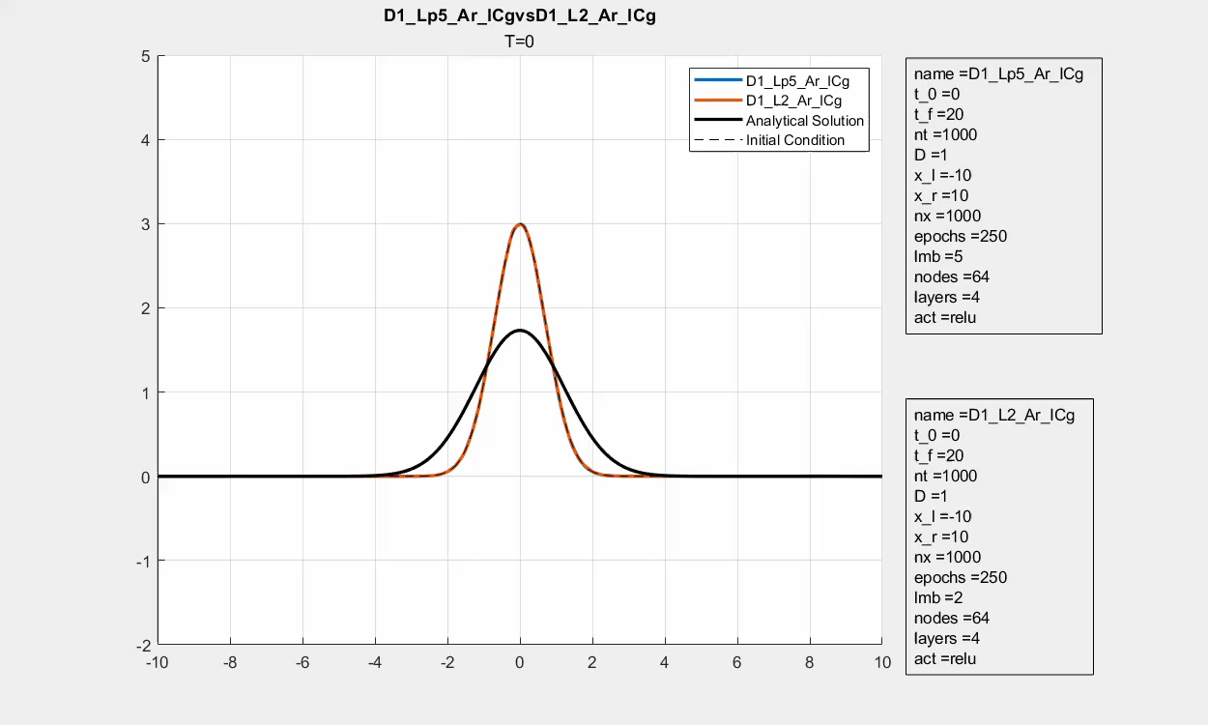
Activation Function

Slide 17
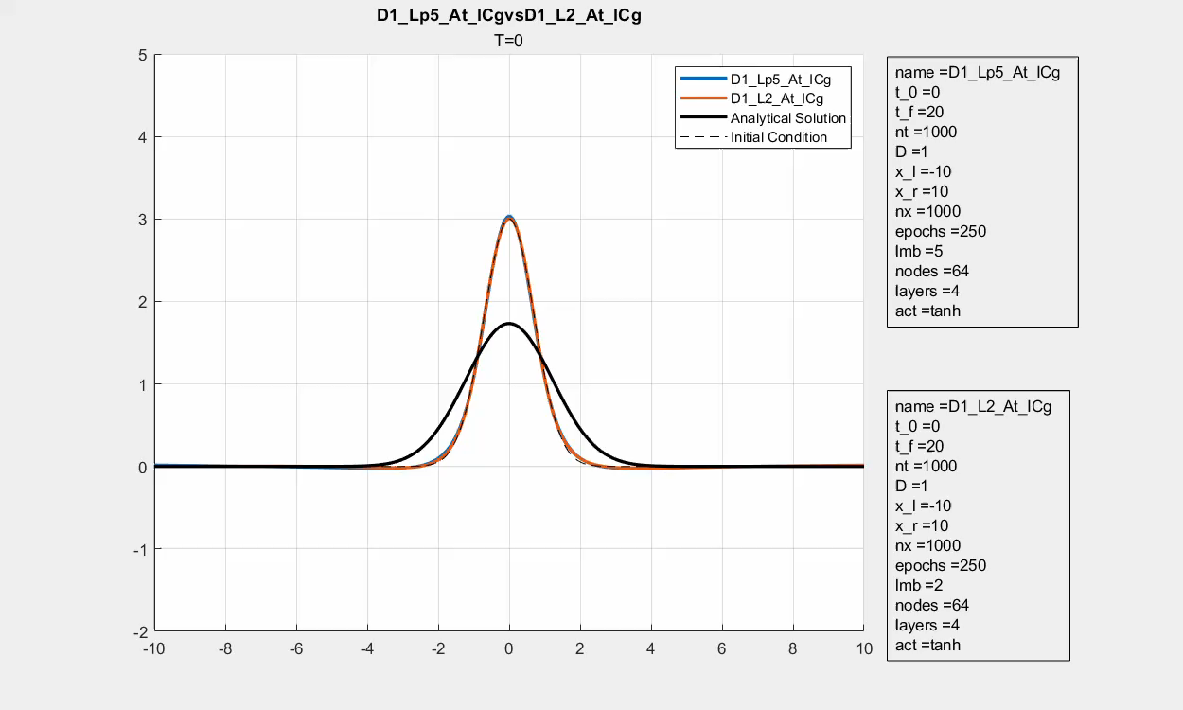
Activation Function

Slide 18
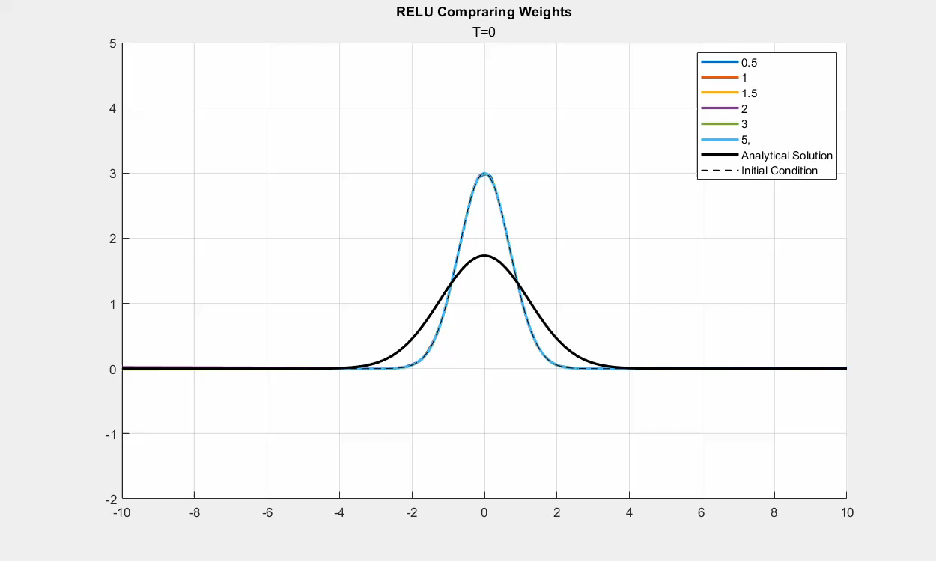
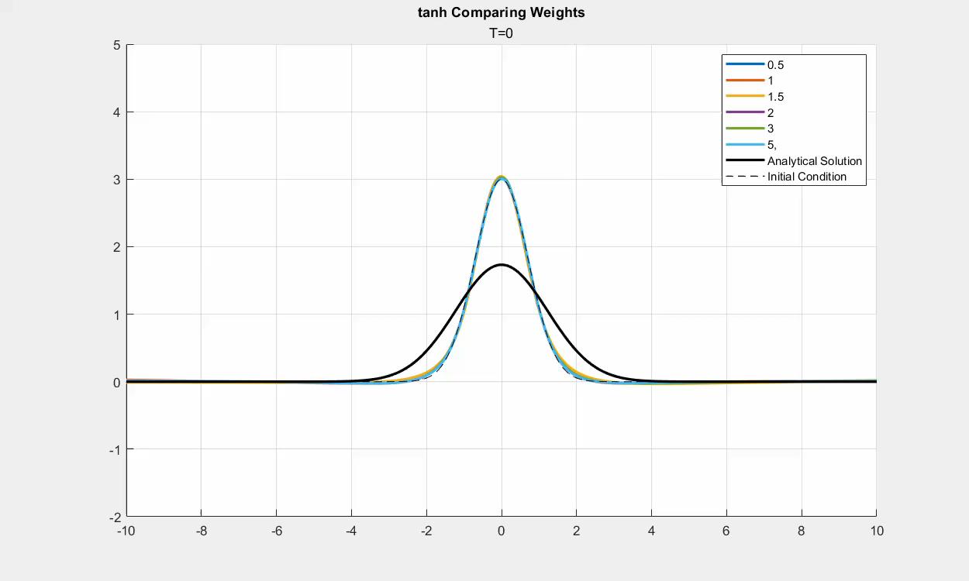
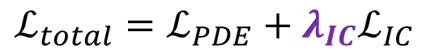
$$ℒ_{total}=ℒ_{PDE}+λ_{IC}ℒ_{IC}$$

Slide 19
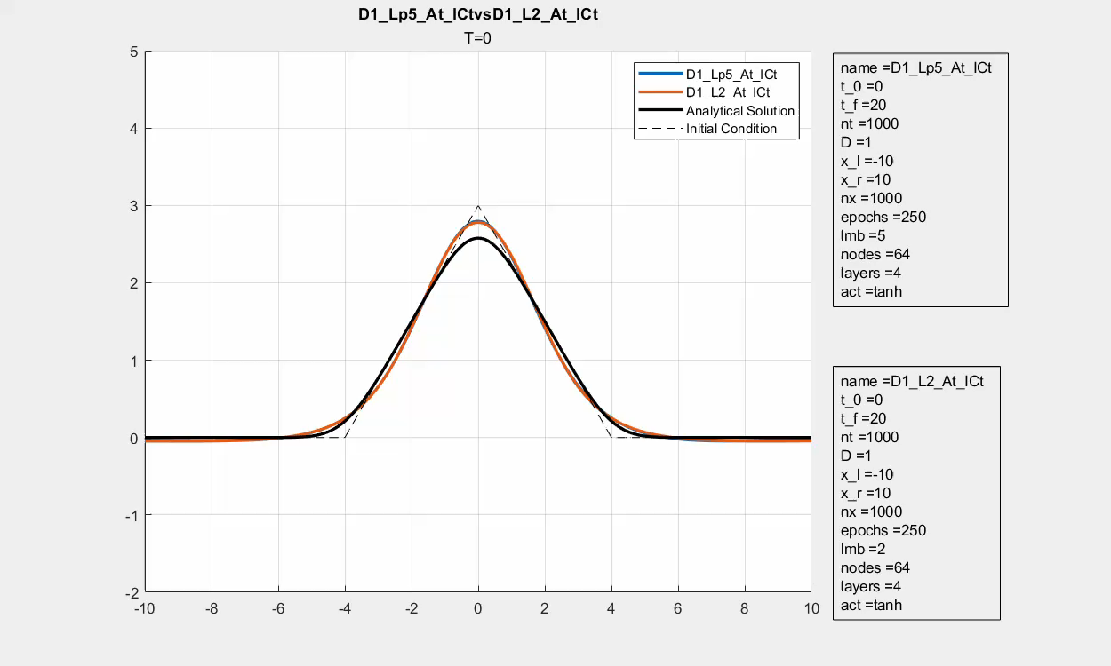

Slide 20
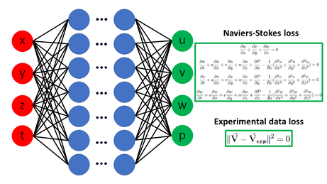
Summary and Next Steps
PINNs provide new opportunities for solving differential equations
Caution must be applied
“Informed” > Good judgment
Sensitivity:
Machine Learning Hyperparameters
Physical Parameters
“Physically-inspired” networks
From Wikipedia: https://en.wikipedia.org/wiki/Physics-informed_neural_networks
Citation for Luo paper
Luo, Shirui, Madhu Vellakal, Seid Koric, Volodymyr Kindratenko, and Jiahuan Cui. “Parameter Identification of RANS Turbulence Model Using Physics-Embedded Neural Network.” In High Performance Computing, edited by Heike Jagode, Hartwig Anzt, Guido Juckeland, and Hatem Ltaief, 12321:137–49. Lecture Notes in Computer Science. Cham: Springer International Publishing, 2020. https://doi.org/10.1007/978-3-030-59851-8_9.

